Slide 1
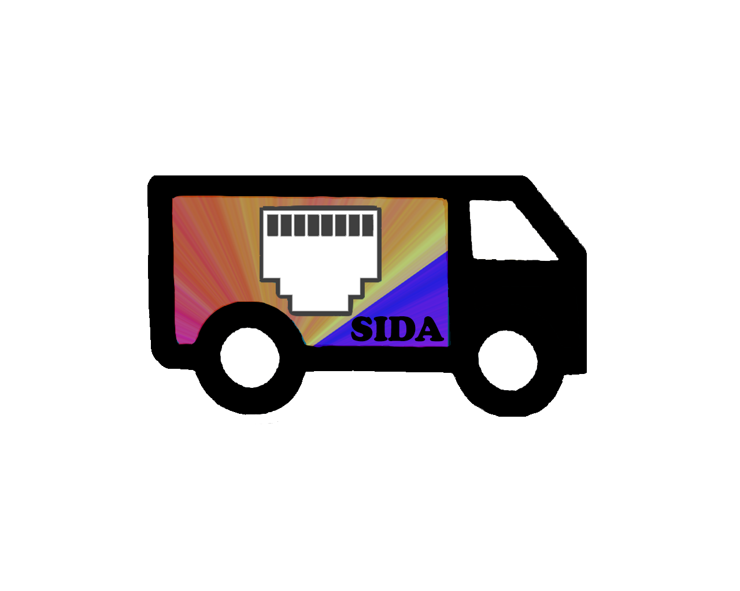
Sida Plug and Play Web Server
Alex Miu, Sam Siegel, Josh McCarter, and Daniel Diseroad

Slide 2
Project Goals
Create a simple and easy to use device that allows the user to create a website hosted on a local network just at the tap of a button.
Useful for nonprofit organizations who don’t have the funds, resources, or knowledge to create their own website.
Sida allows for these organizations to choose from a variety of website templates and customize them to their liking.

Slide 3
Technology Used
Sida uses a mix of Python, Bash, Javascript, and html.
Currently Sida is hosted on a Raspberry Pi 2B, but it could be used with any Linux distro.
The programs Express and Node are used to host the website and to change the template of the website if needed.

Slide 4
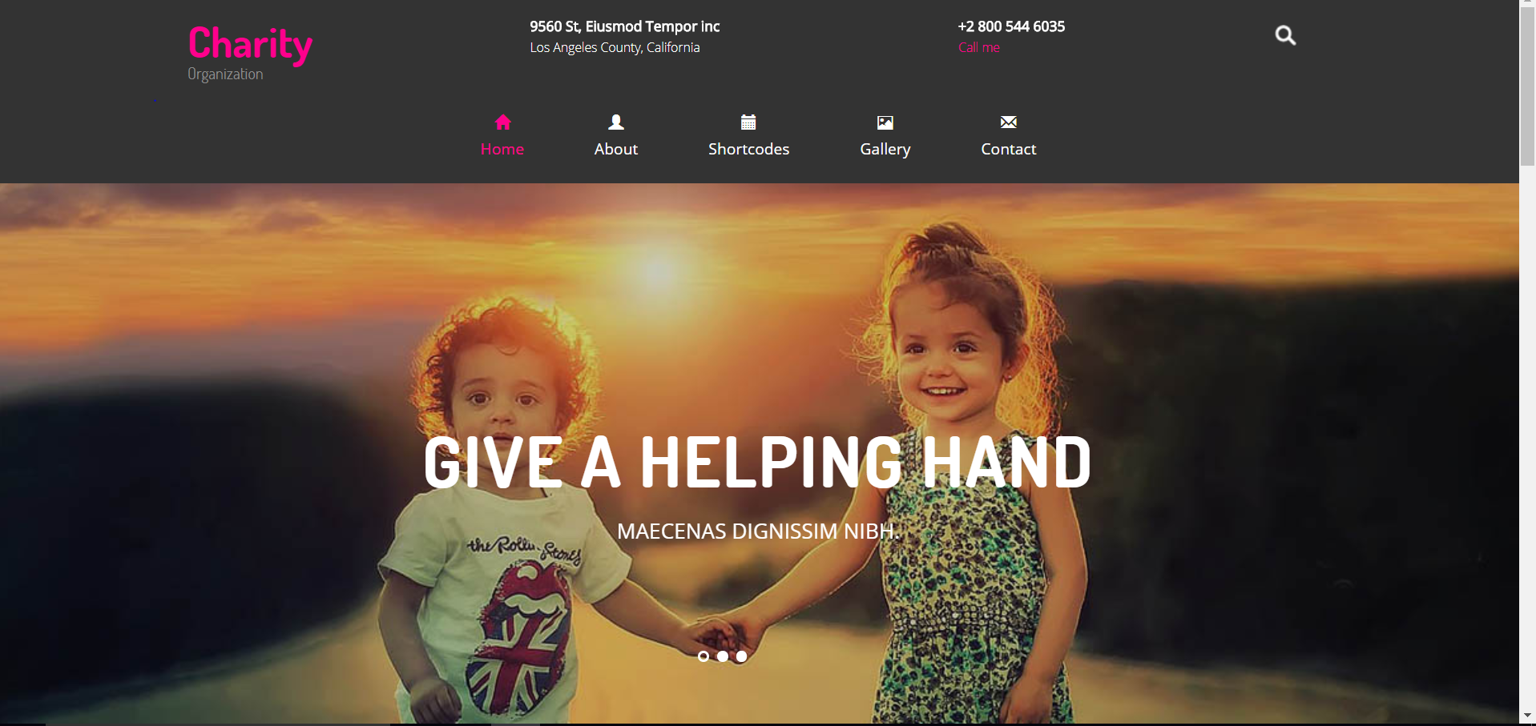
Pictures

Slide 5
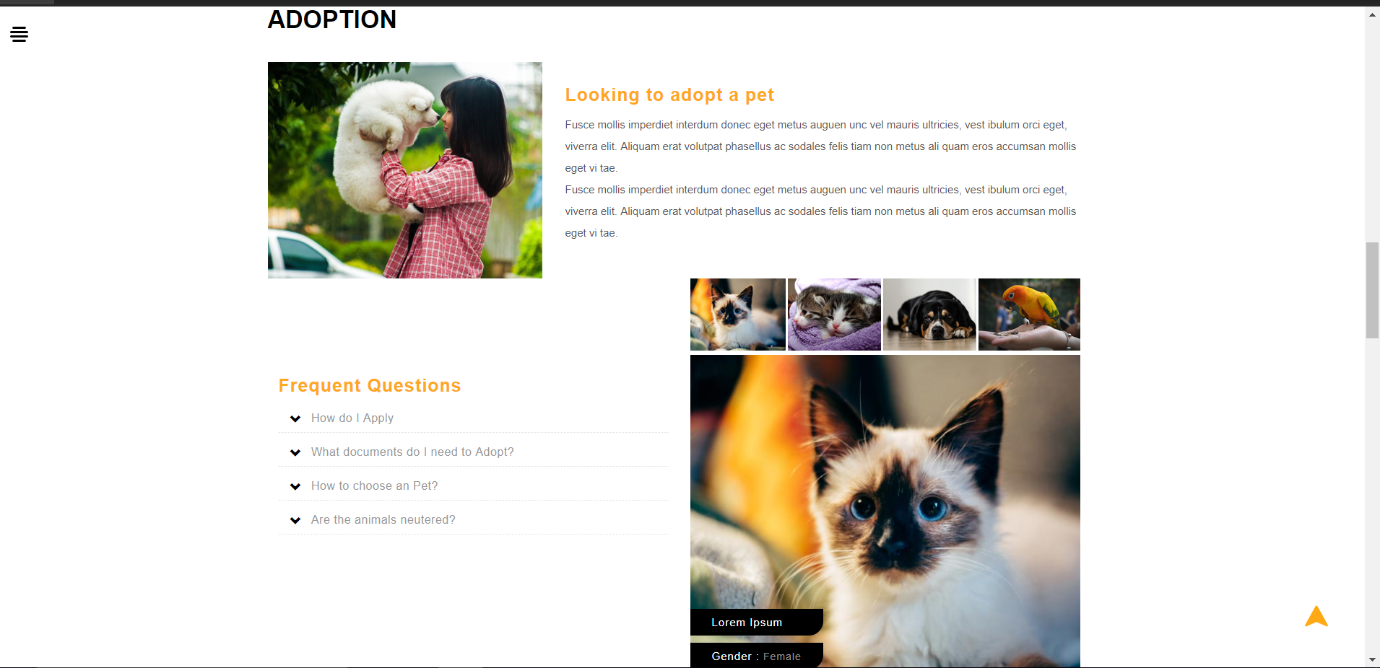

Slide 6
